Slide 1
Doctrine 2
Juozas “Joe” Kaziukėnas
http://juokaz.com / juozas@juokaz.com / @juokaz

Slide 2

Not my name

Slide 3

Who is this guy?
Juozas Kaziukėnas, Lithuanian
You can call me Joe
3 years in Edinburgh, UK
CEO of Web Species Ltd
Occasional open source developer
Conferences speaker
More info in http://juokaz.com
Tweet me @juokaz

Slide 4
Doctrine 2 – PHP ORM framework

Slide 5

What is an ORM?

Slide 6
What is an ORM?
Object-relational mapping in computer software is a programming technique for converting data between incompatible type systems in object-oriented programming languages. This creates, in effect, a "virtual object database" that can be used from within the programming language.

Slide 7
What is an ORM?
Usually maps data from database to objects
Database row === entity instance
Table === entity specification
Objects are awesome, things you learned in OOP 101
Also map relations
Handle types conversions
Data handling functionality on top
Additional functions
Part of good design
Part of Domain model

Slide 8

What problems they solve?

Slide 9
What problems they solve?
Ask someone to use mysql_query nowadays and you might get punched in a face.
Twice.
Because they would also need to use mysql_real_escape_string.
From “The new era of PHP frameworks”

Slide 10
What problems they solve?
SQL everywhere
“old-style” PHP
Hard to understand
No migrations possible
Not OOP
At least not for database interactions
Much more

Slide 11

Issues with ORMs

Slide 12
Issues with ORMs
Don’t work in all cases
If you are building a Facebook+
Adds overhead
Impossible to avoid
Requires very good OOP understanding
Some people just hate them
Read this “ORM is an anti-pattern”

Slide 13

You might still want to use them

Slide 14
You might still want to use them
If you are tired of SQL queries
If you need to bootstrap something quickly
If you like working with objects
For business logic-heavy applications

Slide 15
Frameworks vs From scratch
Your project might end here

Slide 16

PHP ORMs

Slide 17
PHP ORMs
Propel
Started: August 2003
Based on Apache Torgue
Doctrine
Started: April 2006
Doctrine 2:
Started: early 2008
Released: December 22, 2010
A bunch of others I’m not old enough to have used or are really bad

Slide 18

Doctrine 1 problems

Slide 19
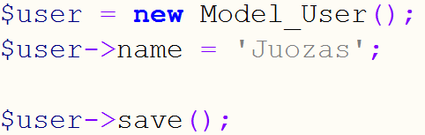
Doctrine 1 problems

Slide 20
Doctrine 1 problems
Slow
ActiveRecord
High memory usage (cyclic references)
Magic! (eg. Behaviors)
Hard to execute raw SQL
Still the best ORM for PHP available yesterday
Popular among Symfony users

Slide 21

Doctrine 2 – let’s have fun!

Slide 22
Doctrine 2 – let’s have fun
Doctrine 2 is going to blow you away
No more ActiveRecord
$record->save();
No more Behaviours
No more slowness

Slide 23
Doctrine 2 – let’s have fun!
PHP 5.3
Based on JSR-317 a.k.a. JPA v2.0
EntityManager
DataMapper
Plain PHP objects
Components
Common
DBAL
ORM
ODM
Optimizations
Performance

Slide 24

Doctrine 2 basics

Slide 25
Doctrine 2 basics
Connection
PDO and native extensions wrapper

Slide 26
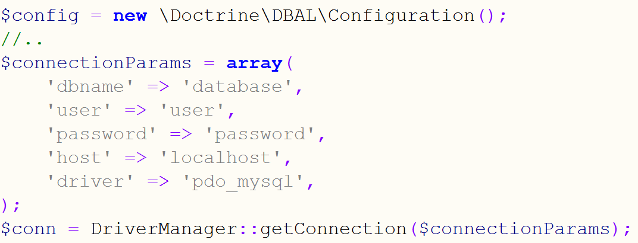
Doctrine 2 basics
Connection

Slide 27
Doctrine 2 basics
Entity
A class
Class defining a data unit
Structure
Persistence specifics
Properties
Metadata information using Annotations, XML etc.

Slide 28
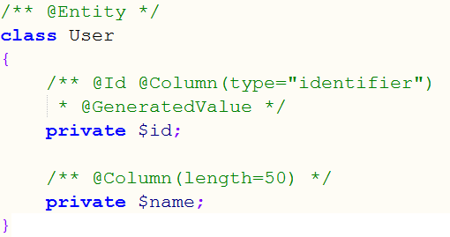
Doctrine 2 basics
Entity

Slide 29
Doctrine 2 basics
Relations
The coolest feature of all
Relations between entities
Types
One-to-one
Many-to-one
One-to-many
Many-to-many

Slide 30
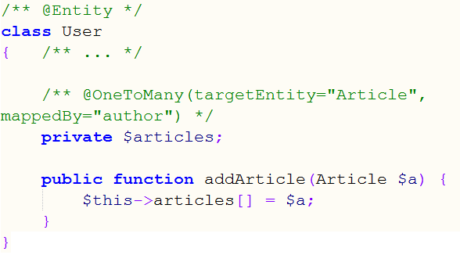
Doctrine 2 basics
Relations

Slide 31
Doctrine 2 basics
EntityManager
Main API
Almost God object
Used to manage entities
Save
Retrieve
Delete

Slide 32
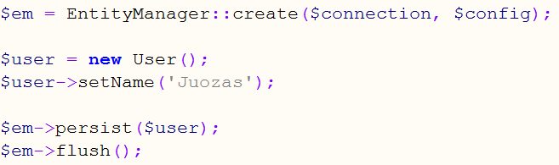
Doctrine 2 basics
EntityManager

Slide 33
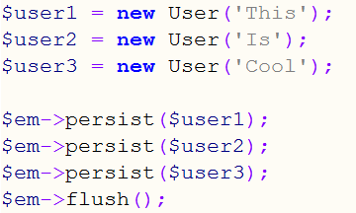
Doctrine 2 basics
EntityManager

Slide 34
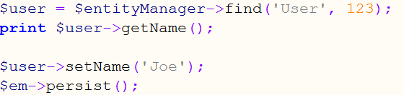
Doctrine 2 basics
EntityManager

Slide 35
Doctrine 2 basics
Querying
DQL – Doctrine Query Language
SQL-kind-of language
Using entities’ class names and properties’ names
Not table names and column names
Returns a (list of) entities, usually

Slide 36
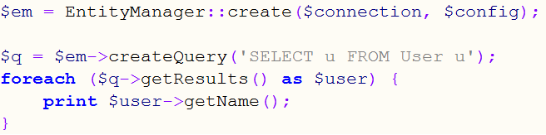
Doctrine 2 basics
Querying

Slide 37
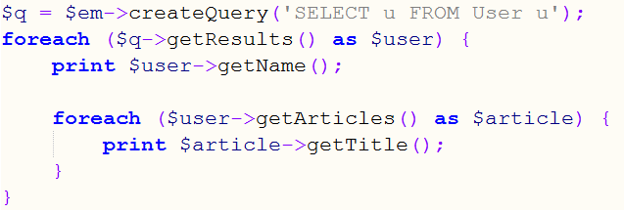
Doctrine 2 basics
Querying

Slide 38

Using Doctrine 2

Slide 39
Using Doctrine 2
Start with CLI
Ready to use with Symfony2
Should be ready with ZF2
Quite a learning curve
It’s worth it
Supports most of the RDBMS and MongoDB, CouchDB

Slide 40
Using Doctrine 2
I used it for…
E-commerce systems
Backend systems for MongoDB databases
Prototyping data structure

Slide 41

Performance/Overhead

Slide 42
Performance/Overhead
Less than you think it is
Still more than Facebook would allow
Are you building the next Facebook?
Much faster and leaner than Doctrine 1
Clever transaction handling
Doctrine is more clever than you
Might be faster than calling mysql_query

Slide 43

Integration with existing apps

Slide 44
Integration with existing apps
Start with DBAL first
Might be tricky to integrate with ORM
Depends on how good your code is
Remember: requires PHP 5.3
Uses PSR-0 class layout, easily autoload’able

Slide 45

Conclusion

Slide 46
Conclusion
Doctrine 2 rocks
Growing more and more popular
Super easy to use with Symfony2
Simplifies things
Depends on your use-case if you’d want to use it
Throw away that Propel code

Slide 47

Thank you!
Keep in touch
http://juokaz.com
juozas@juokaz.com
twitter: @juokaz
Rate at http://joind.in/3587

